Slide 1
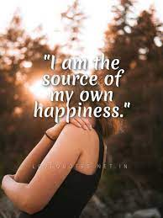
KAJAL DABHI
WEB DESIGNER

Slide 2
I AM…
I am responsible person
I am self aware
I am helpful for other
Quick learner
Introvert
Motivated

Slide 3
I LOVE…
Cooking
Travelling
Playing Garba
Reading
Drawing

Slide 4
I HATE…
I don’t like my insult
Not like to share my personal things
Don’t like lie

Slide 5
S
W
Self-Confidence
Self-Motivated
Creativity
Flexible
Impatient
Over Thinking
Sensitive
Difficulty asking for help
O
T
New career paths that you can take
Develop a skill
Lack of Support
Conflict
Competition

Slide 6
BELIVE SYSTEM
Adaptable
Believing in yourself
Forgiveness

Slide 7
THANK YOU
Small daily improvements over time
lead to stunning results.

